Slide 1
Program Language Technology (2)
CS4158
What is Compilation,
Compiler Architectures Parser Applications
Math Expressions (101)
Jim Buckley
CS1-032
086-1987640
jim.buckley@ul.ie

Slide 2
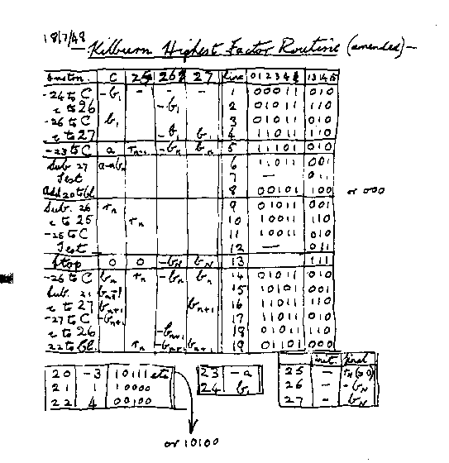
1st Ever Program?
Notes:
<νυμβερ>
The first ever computer as we know it today was developed in 1948 in the university of Manchester (as it was on a computer that could store data and a user program in memory: it was called the Manchester ‘baby’)
Here’s the first program (actually a reconstruction by one of the original developers on the 50th anniversary: Tom Kilburn).
Gets the highest factor of a number ‘a’: Starts at the number and works down to 1 in a variable (lets call it b)
Each b tested by repeatedly subtracting b and finding out if eventually you get down to 0.
Those interested can find more information at: http://www.computer50.org/
Why is this of interest? It shows that originally we had to program in the computer’s language (0, 1). So the right of the fig is design, the left implementation. This made it nigh on impossible to write large software systems or to maintain them afterwards. Think of MS Word in this regard: millions of lines of code, where they need to find specific errors.
We needed a solution

Slide 3
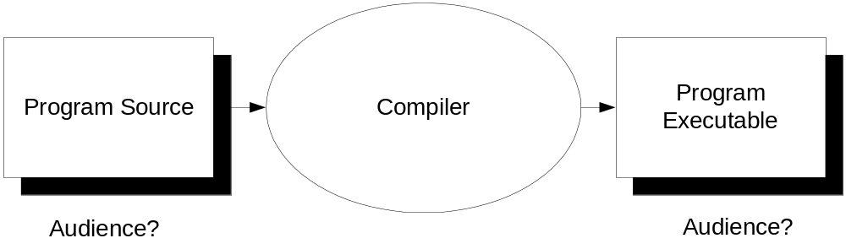
Semantic Translation:
The Role of the Compiler
This translation machine (compiler) is only feasible if its input (program source) has:
  A structure which is described in a reference manual (explicit, standard), is precise and unambiguous;
    And thus is check-able/can be checked;
  Semantics that can be described in terms of (and unambiguously attached to) that structure.
Notes:
<νυμβερ>
Program Source:
Origin of the species was ones and zeros
Difficult to write in and more difficult to maintain;
So, over the years, assembler, C, C++, Java, Modula, Pascal, COBOL, SQL (not necessarily chronologically – more generations-like)
More English like – allows us to write more and more complex systems – so the audience is human
But more distance between it and the run-able executable
For this to be achievable, we need a machine that can translate from the language we can develop / maintain in, to the language a computer can execute; essentially 1s and 0s
This machine can do other things too – like optimize the code for the OS or even for threads
To make this feasible computer programs need a structure: standard, explicit, unambiguous structure, that meaning can be derived from.
Different standard structures are addressed by different compilers

Slide 4
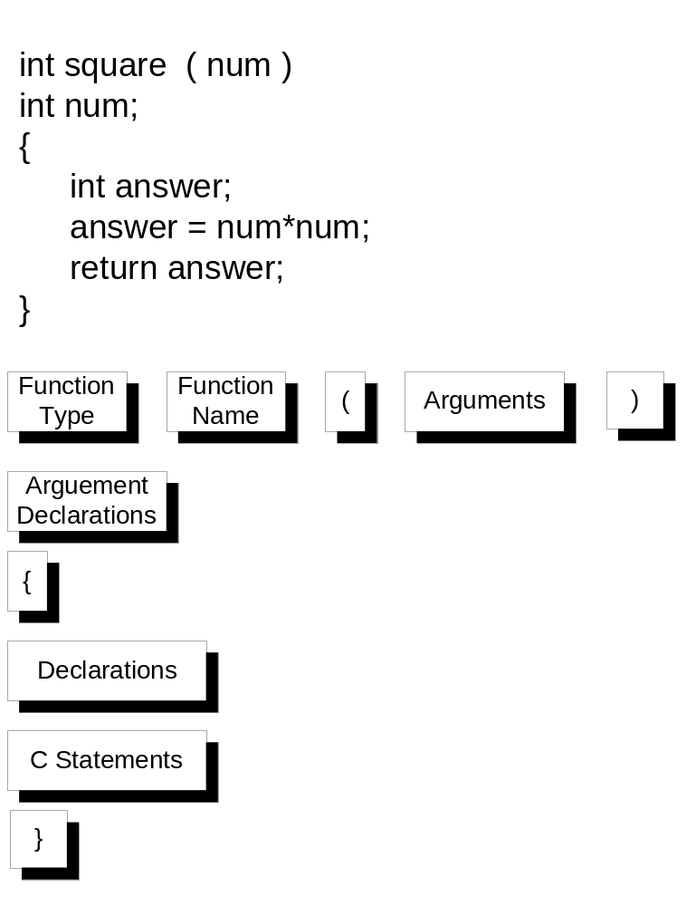
Notes:
<νυμβερ>
So this is taken from my first ever programming manual – bar perhaps the BASIC reference manual that came with my TI994A micro computer back in 1980!
Darnell and Margolis 1990: C A Software Engineering Approach.
Here we see the code, the structure it adheres to. Note that all functions are described by the stated structure Lets explore the implied semantics:
Function type: its going to return this
Function name: everything that wants to access this function, must call this name…

Slide 5
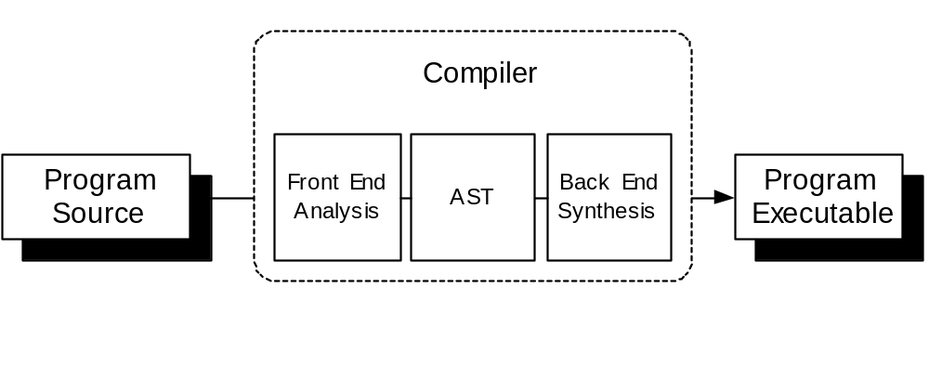
Compiler Architecture
Shows Good Separation of Concerns
Notes:
<νυμβερ>
General thoughts on established architecture
For a given back end, for a new programming language/variant, we just need to tweak the Front End Analysis
Likewsie, for a give programming language, for a new platform, we just need to tweak the Back-end Synthesis: a good separation of concerns

Slide 6
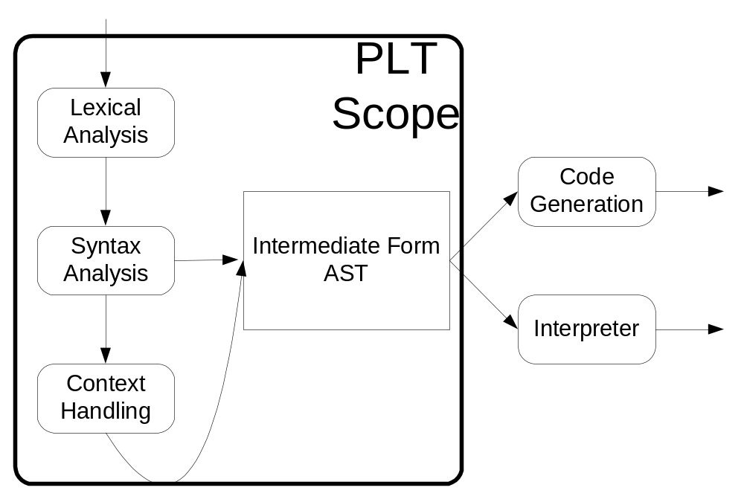
Logical Architecture of Compiler
Notes:
<νυμβερ>
Take this example and talk through
int square ( num )
int num;
{
return(num*num);
}
Draw a picture of how it really works in reality: main calling syntax analyser which calls next lexical analysis as it needs it. Difference between logical view and invocation view.

Slide 7
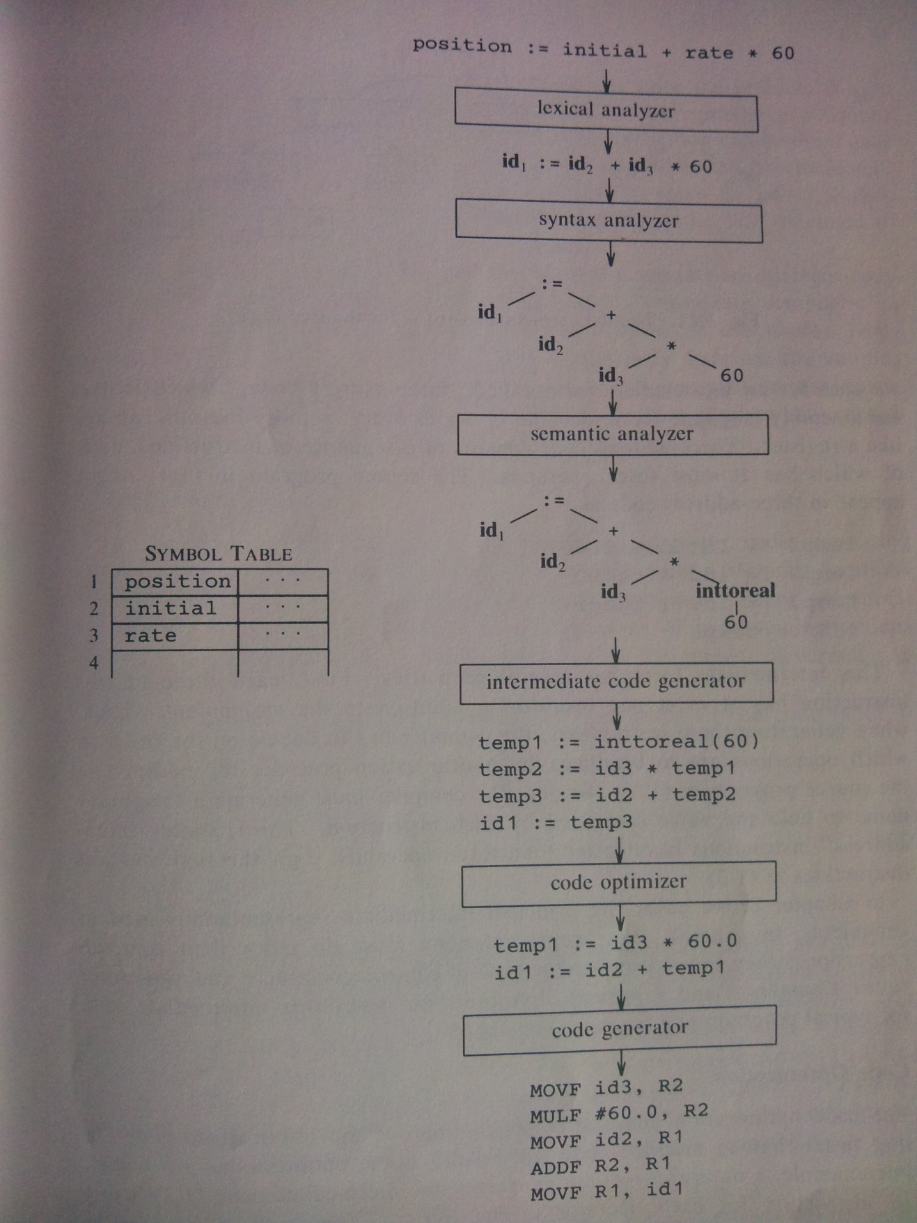
Phases of a compiler: and example
Notes:
Page 13 Aho and Ulman
Note: phase 1: getting the individual words right
Then structuring
Then semantic analysis: error checking including type-information gathering assessment for 60
Intermediate code generation: code for an abstract machine, platform independent but not correspondingly platform efficient
Here 3-address code: assembly language for a machine where every memory location can act like a register.
Compiler must decide that * done first and only one operator on RHS
Code optimization
Platform specific code generation
<νυμβερ>

Slide 8
Variants
‘Interpreter’ Possibility:
  For:
    High Level Portability;
    Much Less Work initially;
  Against:
    Slower during each Execution;
    Non Persistent Executable;
Reverse Engineering tools;
Reengineering tools.
Notes:
Show in diagram
JVM interpreter where source first ‘compiled’ to class files (byte-code) using javac (java compiler): intermediate code generation
Higher level than executable results but less optimized for operating system
Then JVM translates bytecode into operating-system specific calls.
Makes the operating system nearly ‘completely’ irrelevant to the programmer.
<νυμβερ>

Slide 9
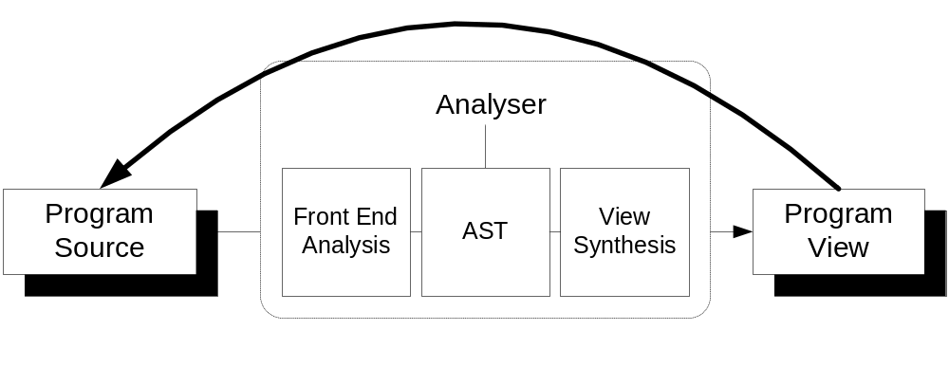
Reverse, re-engineering and S.C. analysis tool Architecture
A Program view may be:
  Graphical/More Abstract Representation;
  Metrics;
  Code:
    Translated Source Code;
    Re-factored Source Code:
    Both of which may in turn by taken as an input to another re-engineering tool, or a compiler;
Notes:
<νυμβερ>
Not just compilers (translating programs for computers to execute)
Reengineering tools are also core users of this approach
Analysing programs for other viewers (humans / other tools)
In fact JITTAC
Ads:
Persistence leads to load once, analyze often cycle.
So if you have an AST centred architecture you could have many front-ends for many different languages and many view syntheses for many program views. If you ad a new front end, then you get all the program views for free. If you add a new View Synthesizer/View, all the languages you have front ends for can be shown in that view: Parser, Repository-Viewer architecture: again fairly standard in reengineering, reverse engineering toolkits.

Slide 10
Reverse Engineering Tools (coming to a lecture near you!)
JITTAC
FLInTS

Slide 11
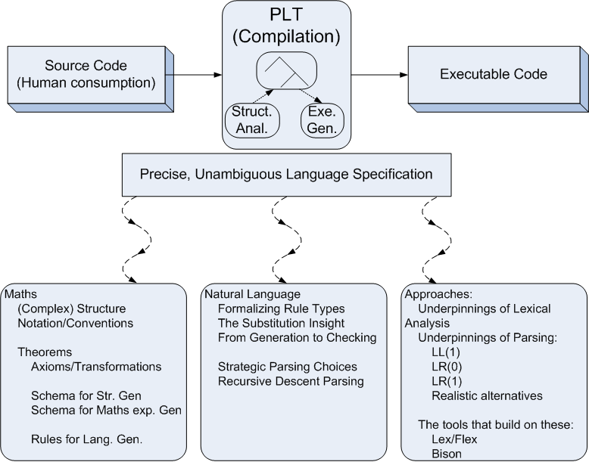
Module Overview
Notes:
Maths suitability because of age, goals of precision and lack of ambiguity and complex structuring
The ‘checking’ under ‘Natural Language’ can be referred to as Parsing
<νυμβερ>

Slide 12
Language Formalization (through the ages!)
Structure in the language of Mathematics
What elements?
What structural conventions?
The importance of these structural conventions...
Notes:
Operators, operands, punctuation
How the symbols should be placed with respect to each other to convey meaning.
Standardized, precise, unambiguous communication between writer and readers, between writer and computer.
<νυμβερ>

Slide 13
And that’s the basis for Compilation
Arithmetic / Algebraic Notations include:
  Symbols:
    Operator symbols;
    Operand symbols;
    Punctuation symbols;
  Conventions:
    Where symbols should be placed with respect to each other….;
    Delimiters.
  These allow:
    Communication:
      Writer to reader: standard understanding;
      Writer to computer: standard understanding;
    Increased sophistication: building more complex expressions from simpler ones;
Notes:
<νυμβερ>
standardized, precise and unambiguous in meaning so that the developer can write it and the computer can read/interpret it.
Mathematicians have concentrated for centuries on developing such languages so that they can have a common interpretation of their communication. One of the major players in this standardization of their precise language was Leibniz in the seventeenth century (famous in particular for contributions in differential and integral calculus). TCD have a good website on the life of this guy: http://www.andrews.edu/~calkins/math/biograph/bioleib.htm
Of course another advantage for us, of studying this standardization is that much of a computer program is made up of expressions – so relevant too. Indeed, if we add extra operators an expression can be seen as a computer program!
Punctuation symbols act as delimiters that delimit an expression (more accurately a sub-expression) that used as an operand in other expressions. – allows complex expressions
(a+5)*7, a+5 being an operand of the *, along with 7.
Note that algorithms that process such expressions need a way to distinguish operators from operands as a starting point. There are numerous ways to do this (tables of operators, etc). But a neat way is to just assign operands an arity of 0

Slide 14
Operator-structural Properties
Arity:
  Unary;
  Binary;
  Ternary?;
  Variable;
Fixity (conventions):
  Horizontal:
    Prefix;
    Infix;
    Outfix;
    Postfix;
Notes:
<νυμβερ>
Note that arity is syntactic (structural) and that fixity is visual – but again helps us interpret.
Unary: sq root
Binary: *,<,
Ternary: maj(a,b,c) / operands can only assume 2 values
Variable: - (negation, in which case its unary, subtraction in which case its binary)
Prefix: – majority, negation
Infix: - in the middle
(Horizontal) Outfix: Integration,
Postfix: factorial
What is exponential

Slide 15
_{m}O_{n} Notation
Succinctly specifying arity and fixity for horizontal operators:
  ₀O₁
  ₁O₀
  ₁O₁
  ₀O_{n}
  _{n}O₀
  _{n}O_{m}
Notes:
<νυμβερ>
We said that we would have to characterize arity and fixity (and we did in a very englishy sort of way)
But we should make this succinct _{m}O_{n:} where:
m stands for the number of operands before the operator, that the operator operates on
n stands for the number of operands after the operator, that the operator operates on
Note it doesnt cope with outfix

Slide 16
Operator Properties Continued
Fixity (Continued):
  Vertical Elements:
    Vertical Infix;
    Subfix?;
    Superfix?;
    Vertical Outfix?;
So not always so easy:
  xy (assuming single letter variables as operand);
  Complex numbers;
  Differentiation;
Notes:
<νυμβερ>
Superfix: exponential
(Vertical) infix: alternative division
Subfix: selection of element
Vertical outfix: ????
Ask them to characterize differentiation, complex
Mention differentiation, complex numbers – to illustrate that what mathematicians do in fact is not so easily characterized.
Lets try to characterize both arity, fixity of both of these

Slide 17
More Complex Calculations
Elementary expressions;
More complex expressions needed:
  Multiple operators;
  Generalizing operands past:
    Literal or Variable;
    to… the result of earlier operation:
      Essentially a sub-expression;
  One of Math’s most fundamental break-throughs but:
    The ‘which operator comes first’ issue;
    The scope issue;
    Intermediate naming option:
      Delocalizes the original formula;
      Introduces many new symbols;
Notes:
<νυμβερ>
Elementary operations: 1 operator operating on its operand(s).
Often we need more complex operations in mathematics – average, or solving (factoring) quadratic equations for example: sq root of –b+- sqroot(b(sq) –4*a*c), all over 2a
This sub-expression – expression concept is one of the most fundamental concepts in maths, allowing unambiguous complex expressions from simple expressions
Scope refers to how long a (say) vertical infix division is scoped to.
Also a which one comes first issue
Often these 2 issues are highly related as per average eg.
Symbols issue is to do with:
Amount of stuff you have to keep on your mental / external representation stack to put back together again
The amount of symbols you can use is limited, especially if you are talking about adhering to mathematical conventions (1-letter symbols)
If you are writing a computer program, you are using needless memory space for temporary variables
Generalizing eq: sq root of b(sqed) – 4*a*c

Slide 18
To get over this: Notation solutions
Horizontal Delimiters:
  Demarking first and last symbols in a sub-expression only:
  ( )
  {}
  < >
  [ ]
Free to use which-ever you like in Mathematics but not so much in computer languages (C for e.g.):
  Meanings of ( );
  Meanings of [];
  Meanings of {};
Notes:
<νυμβερ>
An over-brace highlights all operands and operators in a sub-expression
However, logically, only the first and last symbols need to be identified Suggests what sort of fixity delimiters?
Outfix (horizontal) delimiters of course, one a begin, the other an end to the sub-expression
typically symmetrical ( ), { } if..fi
In maths you can use any delimiters, but in programming languages each delimiter has a specific role
()
passing parameters,
,
macros #define MUL_BY_TWO(a) ((a)+(a)),
Precedence,
[]
Declaration of array size,
Selector from an array;
{}
Left as an exercise of the reader – but I can think of 5.5
Function start, end
Control block start end
Compound statements
Array initialization
Initialization of structures
Class start / end
Typedef start, end

Slide 19

Communication Issues with (Horiz) Delimiters
In reading expressions in 1-D, identical delimiters can cause problems:
  (-b +/- ((b*b)-((4*a)*c)))/(2*a)
Even using different delimiters can be problematic
  (-b+/- [{b*b}-{<4*a>*c}])/(2*a)
And that’s not always available to us in programming languages
Notes:
<νυμβερ>
Get the students to re-write these expressions with stretchable operators

Slide 20
Notational Conventions (that enable sub-exps)
Stretchable Operators:
  Division;
  Any more?
  Improvement in quadratic formula.
Special (Vertical) Delimiters:
  Over-lines, Overbraces;
  Illustrate for “average” equation;
  Illustrate refined notation;
  Expression Trees:
    Highly readable (humans and computers)
    Eliminate delimiters;
    Space for annotation;
    Extensively used in compilers
Notes:
<νυμβερ>
Stretchable
Vertical infix division, extended division delimiter
These deal with scope of the sub-expression operators deal with and implicitly the sequence / ordering in which these operators are applied.
However, the problem is that there are other operations which do not have such ‘stretchability’. How do we identify scope / ordering for these?
Overlines could allow us identify the scope and ordering of all operators – those of variable arity, or those applied to sub-expressions
Expression tress contain sub-trees of sub-expressions. Hence, we must work from the leaves up in evaluating the expression trees.
Give them the box notation too.

Slide 21
Expression Trees
But they suffer from the word-processor 1-dimension problem;
Often addressed by using images to portray expressions.
This can lead to problems too…
  Searching problems;
  Re-use/Refinement problems;
  Display Problems:
    Font size variations;
    Resolution, emphasized when printed;
  Has led to ‘equation’ modes
Notes:
<νυμβερ>
WP 1D problem is that they cant show operators working in the vertical dimension.
This doesn’t just effect expression trees
but also vertical fixity operators,
operators that are stretchable in their vertical fixity
and over-braces.
In their document making recommendations for MathML, the W3 consortium list the inadequacies of this often used approach when web-publishing
Adapted from: http://www.w3.org/TR/MathML2/chapter1.html
Reusing part of the equation would be particularly hard.
The resolution of the equations as images will be around 70 dots per inch, while the surrounding text will typically be 300, 600 or more dots per inch. The disparity in quality is judged to be unacceptable by most people.

Slide 22
Convention-based soln (for delimiter reduction)
“Piggy in the middle”:
    Binary infix operators:
    2+4*3
    What happens the 4:
      If it’s the right operand of ‘+’ then 2+4 is the left operand of ‘*’ = 18;
      If it’s the left operand of ‘*’ then 4*3 is the right operant of ‘+’ = 14;
    More formally:
      Priority;
      Associativity;
Notes:
<νυμβερ>
Core problem is scope: which operand belong to which operator
Several sub-problems (some illustrated with e.g.s contained above):
For stretchable operators, - how far do they extend (the sq root problem, the exponential problem)
For binary infix, unary prefix / postfix operators, - which operator gets the piggy in the middle.
Sometimes we use implicit conventions that we learned in primary school * and / always come before + and – (Priority)
Associativity deals with the situation where the same operators are on either side of an operand. It specifies which operator gets to use the operand first (only important when the order of application of operation impacts on an expression’s meaning.
For an expression a o b o c, there is left associativity of ‘o’: ( a o b ) o c
and right associativity: a o ( b o c ) // 2 to the power of 3 to the power of 2 = (good example)
An operator is associative is the order of application doesn’t matter
Identify an associative operator, a “left and right” associative operator: + or *

Slide 23
Priority
If o1 has a greater priority than o2 then (for binary infix ops):
  a o1 b o2 c = (a o1 b) o2 c;
  a o2 b o1 c = a o2 (b o1 c);
Exponential | ^
Multiplication / Division | * /
Addition / Subtraction | + -
Comparison operators Logical negation Logical and / or | <, >, = ¬ && ¦¦
Notes:
<νυμβερ>
So arity is the number of operand an operator attracts, priority is the strength of that attraction. So weaker (priority) operations only get to use the results of stronger priority operations. In this manner priority mirrors delimiters for binary infix operators – they specify their scope and the relative priorities. Nothing outside can get in. and the operators inside are of highest priority.

Slide 24
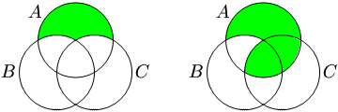
Associativity
(A-B)-C != A-(B-C)
Notes:
20/10/2 = good example
<νυμβερ>

Slide 25
Associativity
Associativity:
  If o1 is left associative then:
    a o1 b o1 c = (a o1 b) o1 c;
  If o1 is right associative then:
    a o1 b o1 c = a o1 (b o1 c);
  Evaluate:
    7+4+2
    7-4-2
    5*5*2
    16/4/2
    4^3^2
Notes:
<νυμβερ>
Associativity: For operators with the same priority: whether you do expressions from the left or the right
(7+4)+2=7+(4+2)
(7-4)+2=7-(4+2)
Addition and multiplication are left associative, as are greatestCommonDenominator (gcd) and leastCommonMultiple (lcm)
Addition, subtraction multiplication and division are left associative normally
Exponential is right associative
Left / right associative by convention only
The issue is that sometimes that is just not what you want to do – the average example.
Also, not just an infix issue: -1-5

Slide 26
Priority’s prevalence in C (and for unary operators)
Scenario:
  Unary prefix operator / unary postfix operator: -i++ //i=0
  Unary prefix operator / binary infix operator; -i+10 //i=5
  Binary infix operator / unary postfix operator; i*50++ //i=7
  (!1)<0 // false !!
  !(1<0) // true !!
  !1<0 // comments
Notes:
<νυμβερ>
http://en.cppreference.com/w/c/language/operator_precedence
-i++; //where i=0; 1 or -1, ++ first
-i+10; //where i=5; -15 or 5, unary - first
i*50++; //where i=7; 357 or 351, ++ comes first
Based on higher unary priority (!1)<0, 0 < 0, false
But otherwise !(1<0) = !false = true.
Sometimes delimiters have their uses.
!1<0 – the ! Happens first: False

Slide 27
Priorities / Associativity in C
Associativity (a=16, b=4, c=2):
  int a+=3;
  int a-=b-=3; // will a = 12 or 15?
  (a==16)¦¦(b==4)¦¦(c==2); //will b get evaluated?
  d = a / b / c; //d= 8 or 2?
www.cppreference.com/operator_precedence.html
Notes:
<νυμβερ>
From:
http://www.cppreference.com/operator_precedence.html
Associativity:
1st expression – only one operator -> 19
+=: right to left - second expression =15
¦¦: left to right – so ‘a’ condition met first. As its an ‘OR’ you have to go to the third condition before you find out its true, but if the first condition was A!=16 then you would not have to proceed
/: left to right so expression = 2, not 8.
sizeof = right to left size of int b is probably 4 bytes, size of that is an int, 4 again.

Slide 28
(Forward) Polish Notation
Priority and Associativity can only take us so far
Step forward Jan Lukasiewicz (1920s)
Complex expressions, unambiguously without delimiters:
All operators assume prefix fixity;
  Examples:
    (3+5) * (7-2):
  Notes:
  This doesn’t solve variable arity operations – fixed arity only;
  Interpretation is also quite elegant but complex
  Stack containing ops and operands can grow quite large:
    +-a/bcd (the + only knows its operands at the end);
Notes:
<νυμβερ>
Good place to make explicit 4characteristics of operands: fixity, arity, priority and associativity
Of course a problem is that often you do not want to create an expression where the priority conventions of methematics are applied in their correct order: A simple eg is average, where we add all the numbers together before we divide. So this is not always a solution to the delimiter issue for binary infix notation
FPN
*+35-72
RPN:
35+72-*

Slide 29
Algorithm to Interpret FPN
Error code Expression :: evaluate_prex(Value &result)
/* Outline of a method to perform FPN evaluation of Exp */
{
if (the Expression is empty) return fail;
else {
remove the first symbol from the Expression, and
store the value of the symbol as t;
if (t is a unary operation) {
get the argument;
if (evaluate_prex(the argument) == fail) return fail;
else result = value of op t applied to the argument;
}
else if (t is a binary operation) {
get first argument, second argument;
if (evaluate_prex(first argument) == fail) return fail;
if (evaluate_prex(second argument) == fail) return fail;
result = the value of operation t applied to first argument
and second argument;
}
else // t is a numerical operand.
result = the value of t;
}
return success;
}
Notes:
<νυμβερ>
Very difficult to create FPN and interpretation is no laugh either. Suffice to say this is recursive in a complex loop. We wont look at this

Slide 30
Reverse Polish Notation
Step forward Charles Hamlin (1950);
Postfix notation, again for fixed arity operators: (3+5)*(7-2);
Advantages: Only a stack of operands in evaluation;
Thus more elegant automatons for evaluation;
When operator is read, it is performed;
Notes:
<νυμβερ>
35+72-*
567+-
56-7+
bb*4a*c*-2a*/
Where creation

Slide 31
Interpreting RPN
while(ch=readch( ))
  {
  if (arity(ch)==0) //if operand
    {
    s.push(ch)
    }
  if (arity(ch)!=0) // operator
    {
    for(i=0;i<arity; i++)
      {
      t[i]=s.pop;
      }
    s.push(evaluate(t, ch, i);
    }
  }
Notes:
<νυμβερ>
Assumptions you are reading in expression left to right
You have a stack that takes ints with pop and push functionality
You have 2 functions – one that calculates arity for operand and operators, one that evaluates an operators application to an array of operand ints.
Try: (a+b)*c -> ab+c*
a+(b*c) -> abc*+
So very easy to interpret RPN: and thus, unsurprisingly, there have been a number of compilers built upon this basis- meaning that the language they parse has to be based on RPN: examples include Forth (before you time) and postscript. Ghostview is simply an interpreter that interprets postscript programs (ie files), the interpretation being put up on screen.
Postscript uses many literals and a number of operations

Slide 32
Break-point
We have looked at Maths expressions to see their structuring, notation and various means of ensuring no ambiguity in that structuring/notation;
But we haven’t gotten near defining explicit rules for legality of (maths) expressions yet,
  Let alone assessing maths expressions for that legality;
  Let alone assessing language instances for legality;
So lets try to get closer to this goal in this lecture, by seeing how we could possible start defining rules that might allow us generate legal expressions and eventually help us check expression’s legality.
Notes:
Priority, associativity, punctuation, elongation etc,
<νυμβερ>

Slide 33
Proof in Mathematics
In the 1800s, mathematicians became interested in formalizing the concept of proof:
  Axioms;
  Rules of inference;
  Theorems:
    Applying rules to axioms;
    Sequence of statements,
      Deducing new axioms;
      Applying the rules to the original axioms and then to the new axioms
Notes:
<νυμβερ>
Proving one thing from another in a mechanical manner. For that they needed a starting point and rule that they agreed were allowable:
Axioms: self evident truth. Sometimes substituted by propositions which are things that are taken as self evident truth for the sake of argument
Rules of inference: rules that specify the manipulation of these axioms, and are guaranteed to yield other true statements.
xx=x²
1x=x=x1
x(x+y)=xx+xy
Look at : http://en.wikipedia.org/wiki/Distributive_law
For a definition of distributive law
So we start with an axiom, applying rules to it and transform it into another form, that equates to it

Slide 34
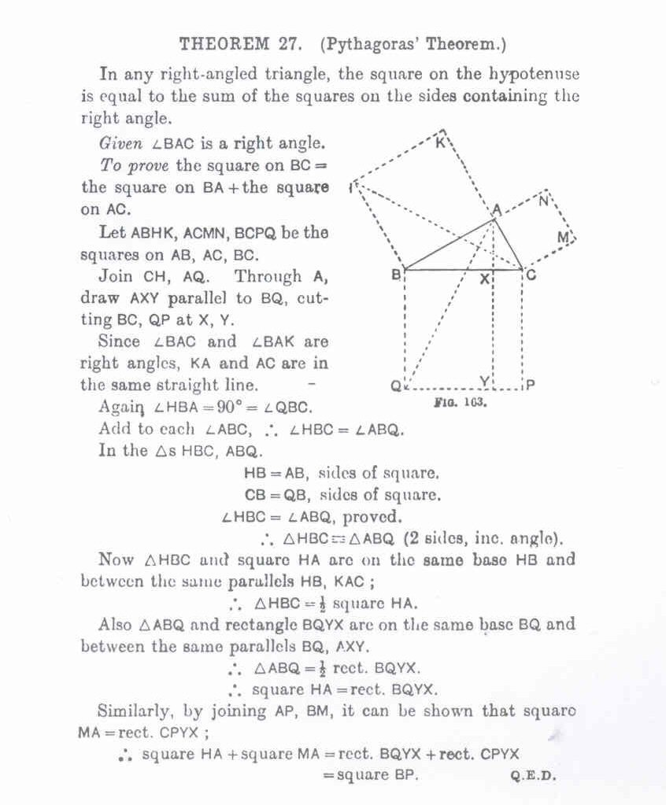

Slide 35
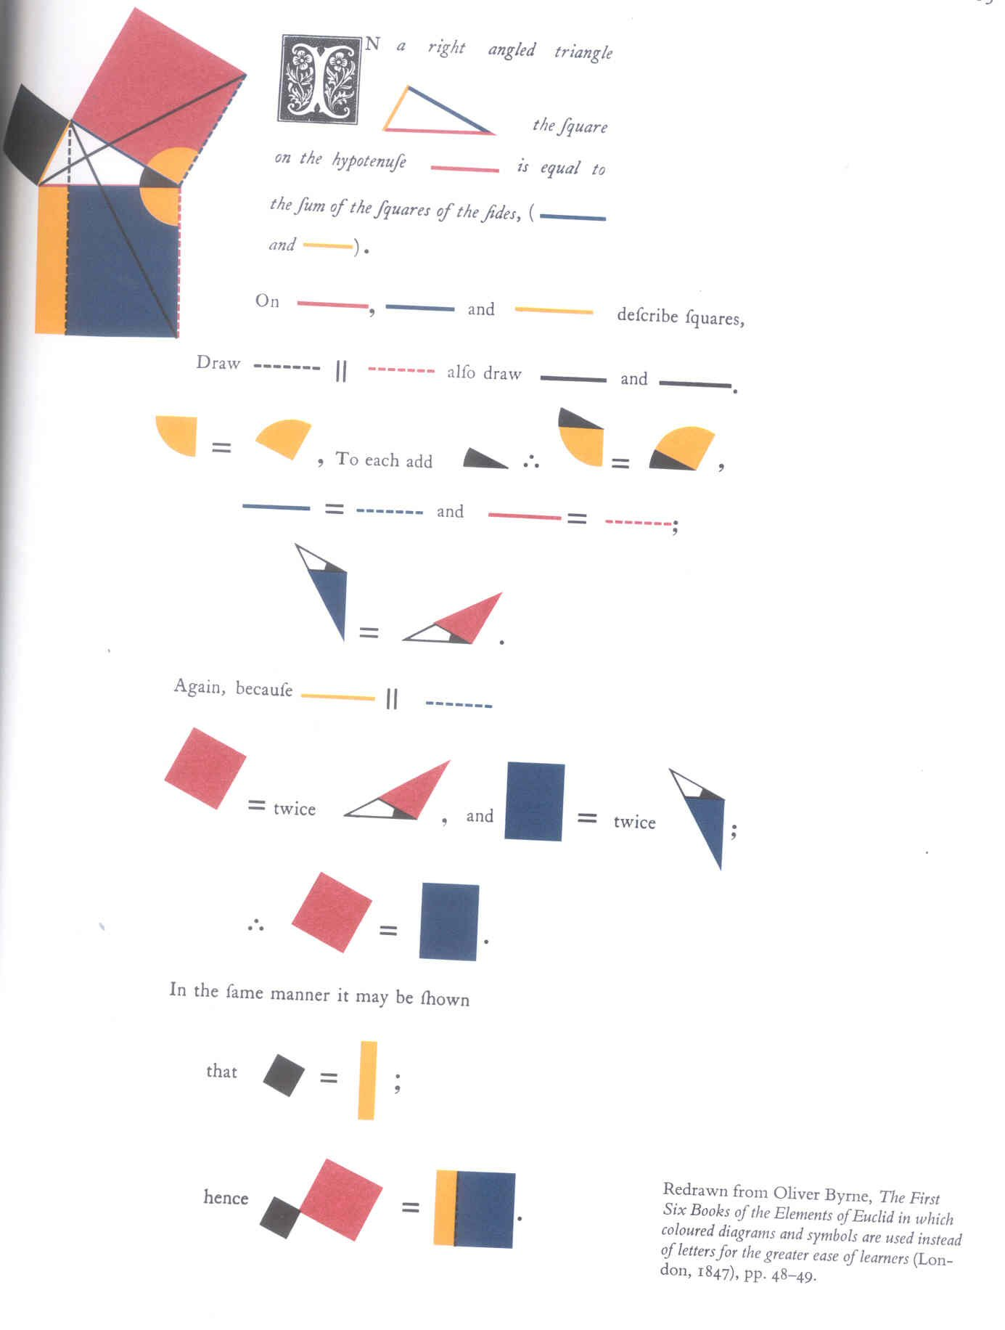
Interesting aside...
Notes:
1847: Oliver Byrne -
<νυμβερ>

Slide 36
Characterizing Proof:
(x+y) ²=x²+2xy+y²
Prove this
Axiom:
  (x+y)²
(Truth-preserving) Rules:
  R1: xy=yx: multiplication is commutative
  R2: x(y+x)=xy+xx: multiplication distributes over addition
  R3: x²=xx: Definition of square
  R4: 1x=x=x1: Definition of Identity
  R5: 1+1=2: Definition of 2
Leads to the following layout:
Notes:
<νυμβερ>
This is a comparative equation with lhs being hypothesized as equivalent to rhs
Begins with lhs=rhs line
And subsequent rhs lines until we get to original rhs we wished to prove.
Need an inference rule that explains how the preceding rhs gets to the next rhs version
(x+y)² = x²+2xy+y²
(x+y)²=(x+y)(x+y) // Definition of square
=(x+y)x+(x+y)y // Use of distributive law
=xx+yx+xy+yy // Use of Distributive law
=xx+xy+xy+yy // Use of Commutative law
=x²+2xy+y² // Definition of square, gathering of xy
Really the rule is about any 2 numbers (with x and y only standing for any said numbers)

Slide 37
More Formal Proof
(x+y) ² | =(x+y)(x+y)
 | =(x+y)x+(x+y)y
 | =x(x+y)+(x+y)y
 | =x(x+y)+y(x+y)
 | =xx+xy+y(x+y)
 | =xx+xy+yx+yy
 | =xx+xy+xy+yy
 | =xx+xy1+xy1+yy
 | =xx+xy(1+1)+yy
 | =xx+xy2+yy
 | =xx+2xy+yy
 | =x²+2xy+yy
 | =x²+2xy+y²
Notes:
<νυμβερ>
Leads to a statement of proof that a machine, or someone who had been trained to follow rules could check, without understanding the meaning of any symbol, just by mechanically checking that they rules had been applied correctly.
This gave mathematicians an insight into purely mechanical reasoning – based on form of statements rather than on semantic content. Hugely important preoccupation of mathematicians and computer scientists ever since:
Emil Post (we will see soon),
Alan Turing, inventor of the turing machine: code breaker during WW2, one of the earliest programmers
Anthony Hoarare inventor of axiomatic semantics – proving the behaviour of programs
John McCarthy: Inventor of lisp
But also shows how rules applied to initial truth can form new truths in the same vein

Slide 38
Post’s Production Systems
Towards generation of strings with some properties;
Adopting the formal notion of proof (1943);
Transformations:
  Governed by:
    Starter strings with those properties;
    Rules specifying how to separate strings into parts and rearrange, extend, insert and delete those parts;
    While maintaining the property;
    Called a ‘Production (Rule)’;
Production Systems:
  Symbols;
  Axioms;
  Productions.
Notes:
<νυμβερ>
Need a diagram here showing how I have looked at Maths proof – in a quite familiar way to us new-age learners – and then shown how it can be employed in expression building
Post was the guy who did a lot of the formalizing of mathematical proof and in his context, it was in generating strings with some property:
(x+y)² changed into a string with the sameness property (result)
Expressions changed into later expressions
So lets take a jump back into his work explicitly
1943: formalized the notion of a proof as a mechanical transformation of strings of symbols where each transformation yielded a string of symbols that followed from earlier strings.
Remind them that this was what I meant when I stated that early attempts were based on trying to generate strings of symbols
In this contexts the axioms were strings of literals that were known to have some property.

Slide 39
Simple Example
Basis:
  E = set of even numbers in unary notation
  We know 11 is an even, unary number
  We also know that if S is even, then S+2 (11) is also even.
More formally:
  E. Literals { }
  E.Variables { }
  E.Axioms ={ }
  E.Productions={ }
Notes:
<νυμβερ>
Note, the -> here no longer stands for logically implies – it just stands for the operation that produces the text on the rhs from the lhs and the application of a rule.

Slide 40
Simple Example
Basis:
  E = set of even numbers in unary notation
  We know 11 is an even, unary number
  We also know that if S is even, then S+2 (11) is also even.
More formally:
  E. Literals {1}
  E.Variables {S}
  E.Axioms ={11 ε E}
  E.Productions={S ε Ε −> S11 ε E}
Now try for Unary odd numbers...
Notes:
<νυμβερ>
Got them to try unary addition.

